Slide 1

Wipro NGA Pre Skilling Training - DWS
Capstone Project Presentation- 4th September, 2025
Title- PSADT Deployments on VM and Running/Modifying script based on requirement
Presented By-
34851- Krishna Verma
Email - kv979539g@gmail.com
www.rpsconsulting.in

Slide 2

INTRODUCTION
POWERSHELL APP TOOLKIT
  PSADT (PowerShell App Deployment Toolkit) is used to create, test, and modify deployment packages.
  Project focuses on wrapping a standard installer (e.g., MSI), testing in VM, and modifying scripts.
  Goal: automate installations with conditions, logging, and registry edits.

Slide 3
OBJECTIVES
  Automate deployment of apps using PSADT.
  Provide standardized install/uninstall mechanism.
  Demonstrate deployment inside VM.
  Generate logs and registry keys for verification.
  Gain hands-on scripting experience.

Slide 4
Project Requirements
  Windows 10/11 Virtual Machine
  PowerShell 5.1 or later
  PSADT Toolkit
  App Installer (7-Zip MSI/EXE)
  Text Editor (VS Code / PowerShell ISE)
  Admin Privileges

Slide 5
Architecture Diagram
Virtual
Machine
PSADT
Toolkit
Deploy-Application.ps1
Logs + Registry
Application Installer

Slide 6
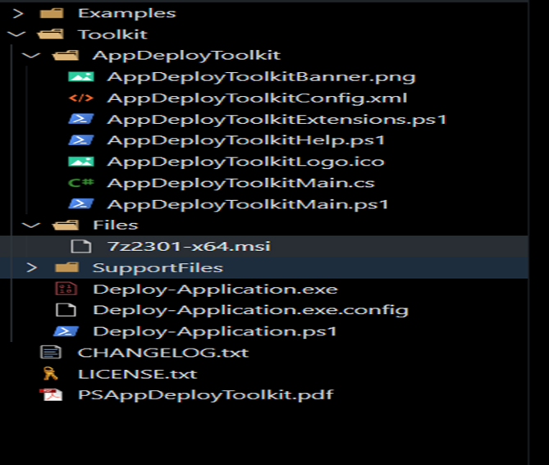
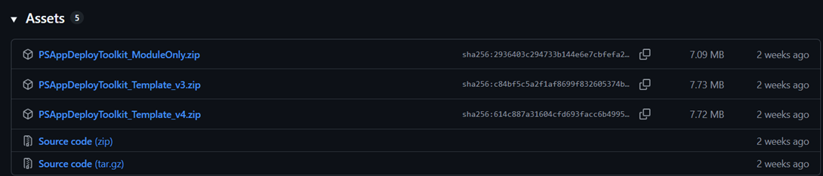
STEPS
Step 2 – Project Folder Setup
  Placed 7-Zip MSI installer inside the Files folder.
  Ensured proper folder structure for deployment package.
Step 1 – Initial Setup
  Downloaded the latest PSADT from GitHub.
  Extracted files into project root directory.
  Verified key files: Deploy-Application.ps1, AppDeployToolkitMain.ps1
download

Slide 7
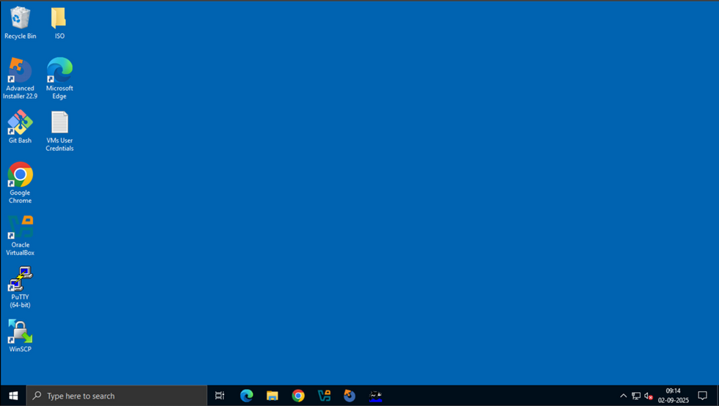


Step 3 – Virtual Machine Preparation
  Configured clean Windows 10/11 VM.
  Updated PowerShell to version 5.1+.
  Acquired Admin privileges for testing.
Step 4 – Script Modification
  Edited Deploy-Application.ps1.
  Added installation logic using Execute-MSI.
  Added uninstallation logic using Execute-MSI -Action Uninstall.

Slide 8
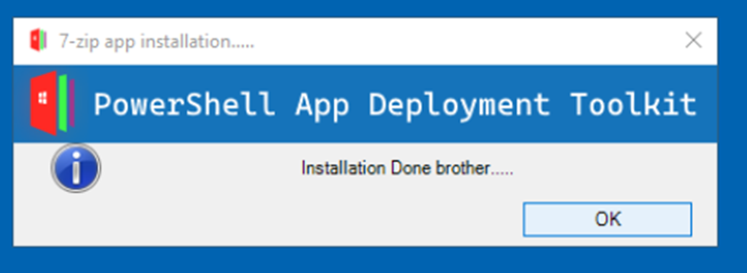
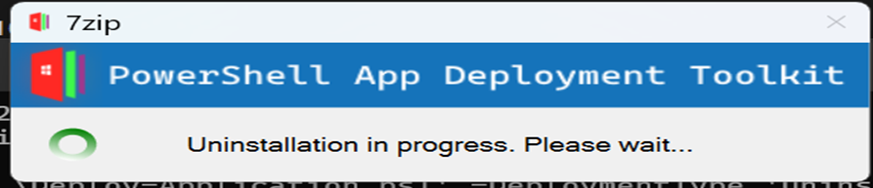
Step 5 – Run Deployment
  Executed script with:
.\Deploy-Application.exe
  Verified installation of 7-Zip.
  Executed uninstall with:
.\Deploy-Application.exe – DeploymentType ‘Uninstall’

Slide 9
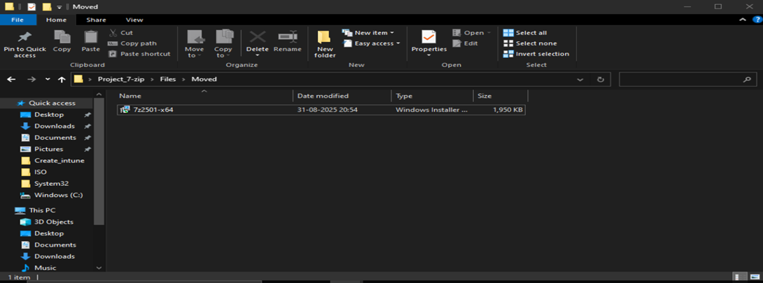
Script Modification
Post-installation action: Move installer file to another folder
Move-Item -Path "" -Destination "" -Force
Added logic for registry validation

Slide 10
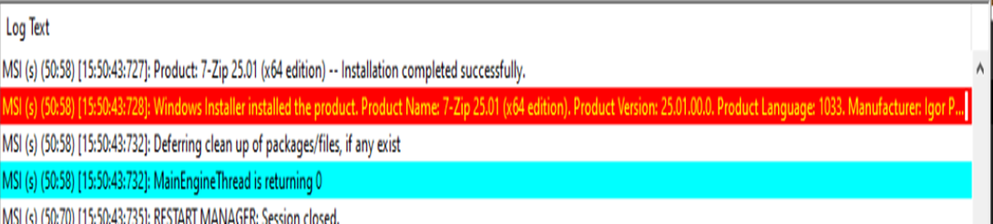
Verification
Logs:
Path → C:\Windows\Logs\Software or AppDeployToolkit\Logs
Confirm success/failure entries.

Slide 11
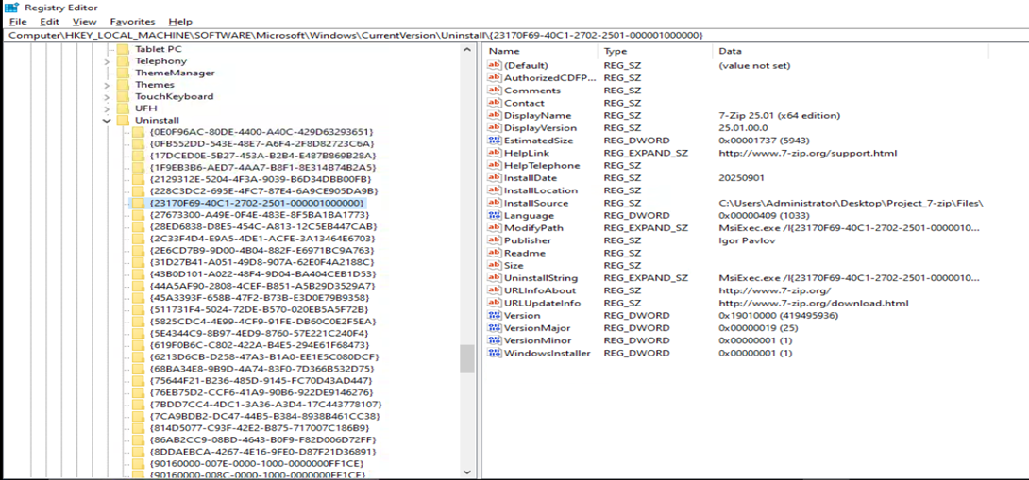
Registry:
Path→HKLM\SOFTWARE\Microsoft\Windows\CurrentVersion\Uninstall
Verify app entry present (7-Zip).

Slide 12

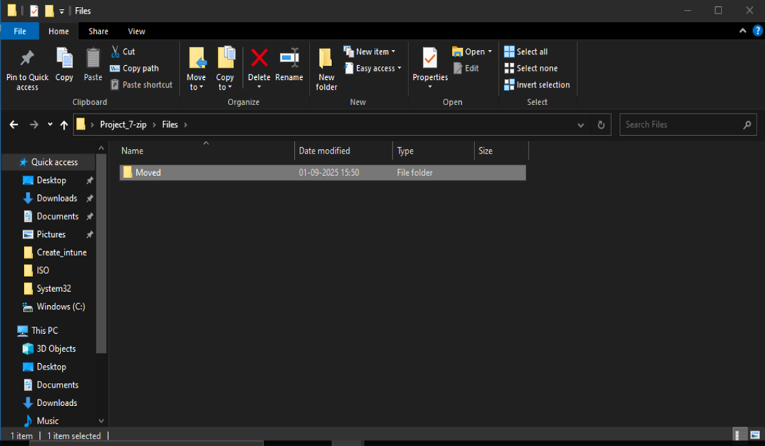
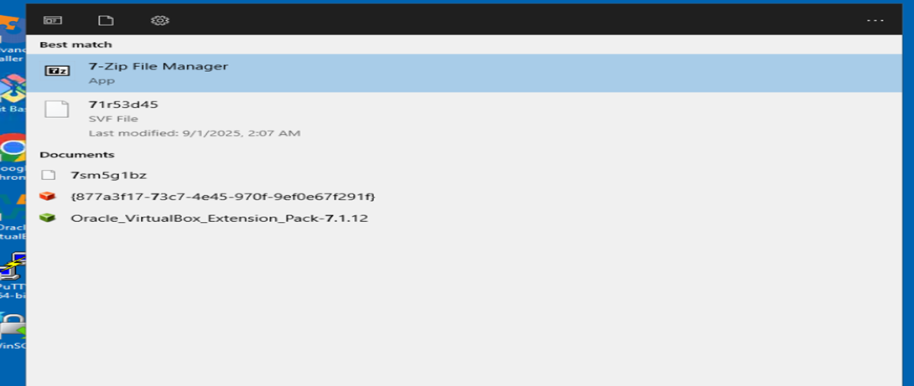
Results
7-Zip installed successfully in VM
Script moved installer post-install

Slide 13

References
  https://github.com/PSAppDeployToolkit/PSAppDeployToolkit
  https://psappdeploytoolkit.com/docs/reference
  https://www.7-zip.org/
  https://www.advancedinstaller.com/application-packaging-process.html

Slide 14
Conclusion
  Successfully demonstrated application deployment using PSADT in a VM environment.
  Automated install, uninstall, and post-install actions with script customization.
  Verified success through logs and registry entries, proving reliability and standardization.

Slide 15
THANK YOU
www.rpsconsulting.in

